Slide 1
The Integrated Orbit of Asteroid 138846
(2000 VJ61)
Odelia Lorch, Yunfei Ma, and Elaine Zhu
01 August 2017
Summer Science Program, University of Colorado Boulder

Slide 2
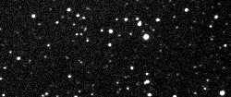

Asteroid: 138846 (2000 VJ61)
Semi-Major Axis (a): 2.18489487717 AU
Eccentricity (e): 0.563025042711
Inclination (i): 18.6827638507°
Longitude of Ascending Node (Ω): 270.576935051°
Argument of Perihelion (ω): 280.482673864°
True Anomaly (ν): 88.1623761985°
Size: 2.0 - 4.5 km diameter
LINEAR - Lincoln Laboratory ETS, New Mexico

Slide 3
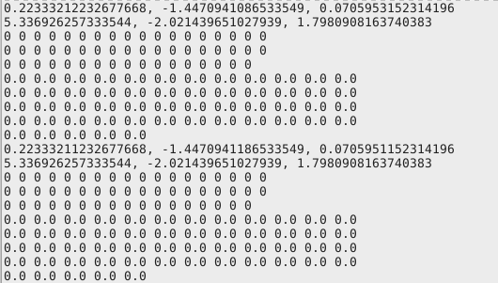
Changes Made to Asteroid
Changes in the eighth decimal place (corresponding to 1 km)

Slide 4
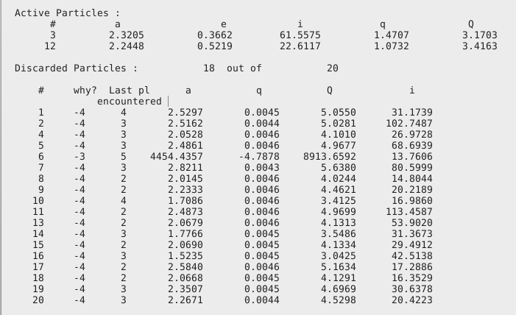
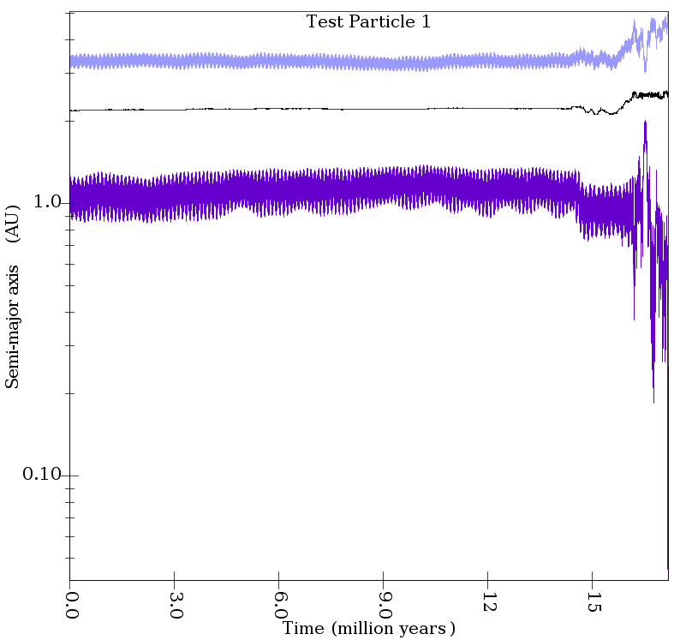
Odelia’s Data

Slide 5
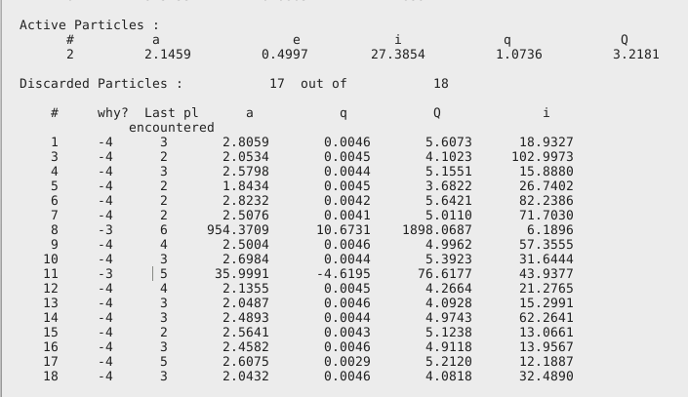
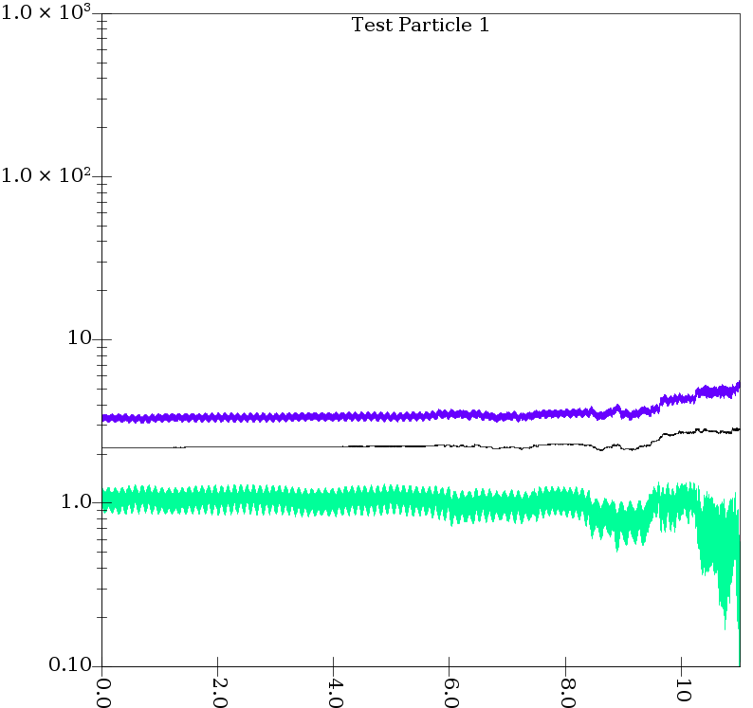
Elaine’s Data

Slide 6
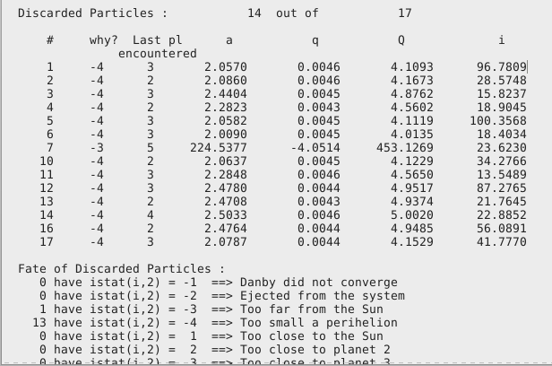
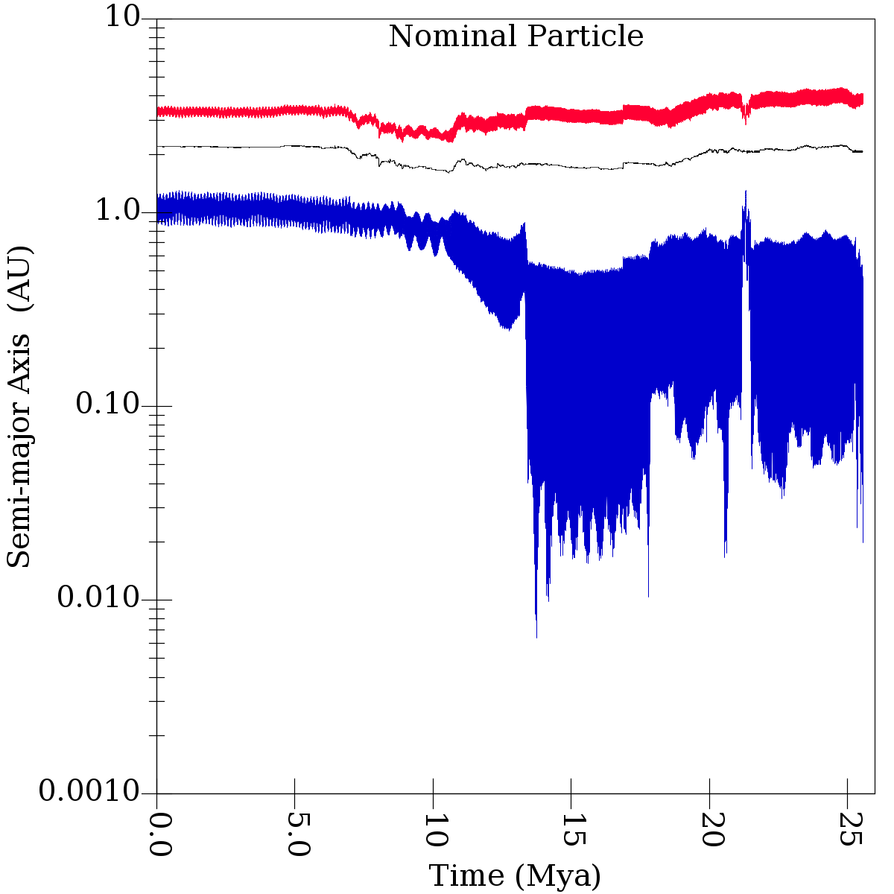
Yunfei’s Data

Slide 7
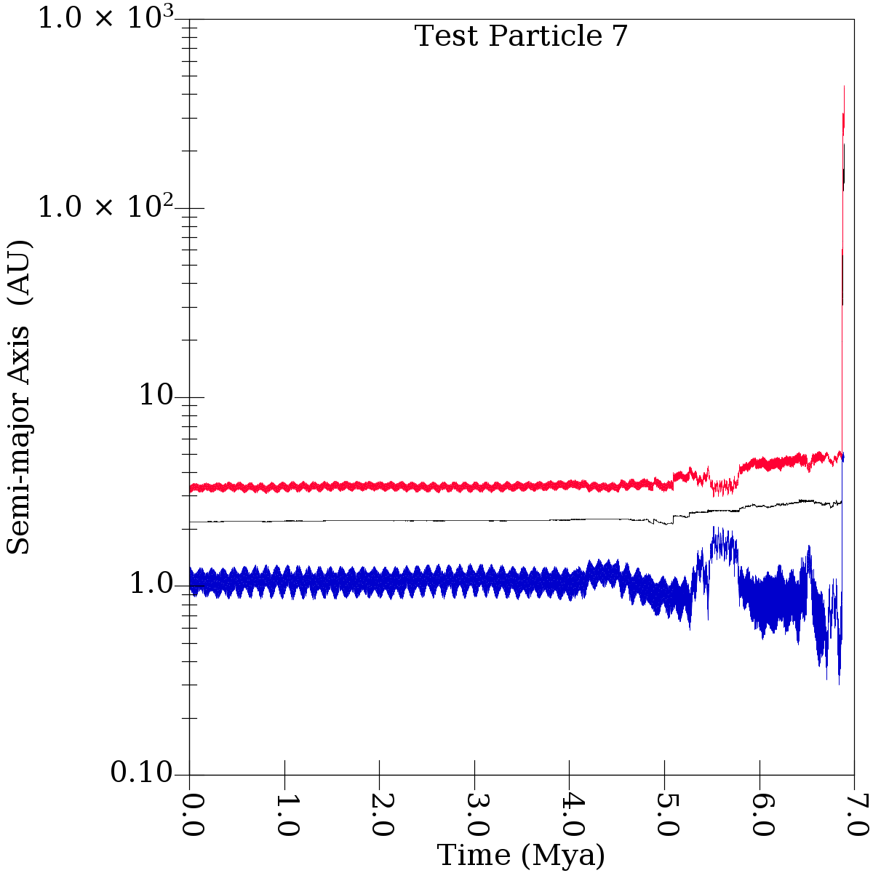
Fate of test particles: two scenarios
76% chance too close to Sun, last planet Earth/Venus 6% chance shoot off from Jupiter

Slide 8
Animation!

Slide 9





In conclusion…. 2000 VJ61 is not a threat!

